Slide 1

Unity VR Setup
By Henry Bryant

Slide 2





Recap - Unity Collaboration

Slide 3
Reminders
Unity Account Sign Up
We won’t be able to build our projects without a Unity Account!
Unity Version Consistency
Make sure all members of your group are using the same version of Unity Editor
Setup Version Control!
Refer back to last weeks tutorial if you haven’t set up GitHub yet
Helplines
Unity Documentation
bryanthc@vcu.edu

Slide 4

Timeline
Week 4 - Unity Collaboration
Week 5 - Virtual Reality Setup
Week 6 - Colliders, Triggers, Scene Changes, Animation, Buttons Triggers
Week 7 - Lighting & Sounds
Week 8 - Optimization
Week 9 - Midterm Presentations

Slide 5
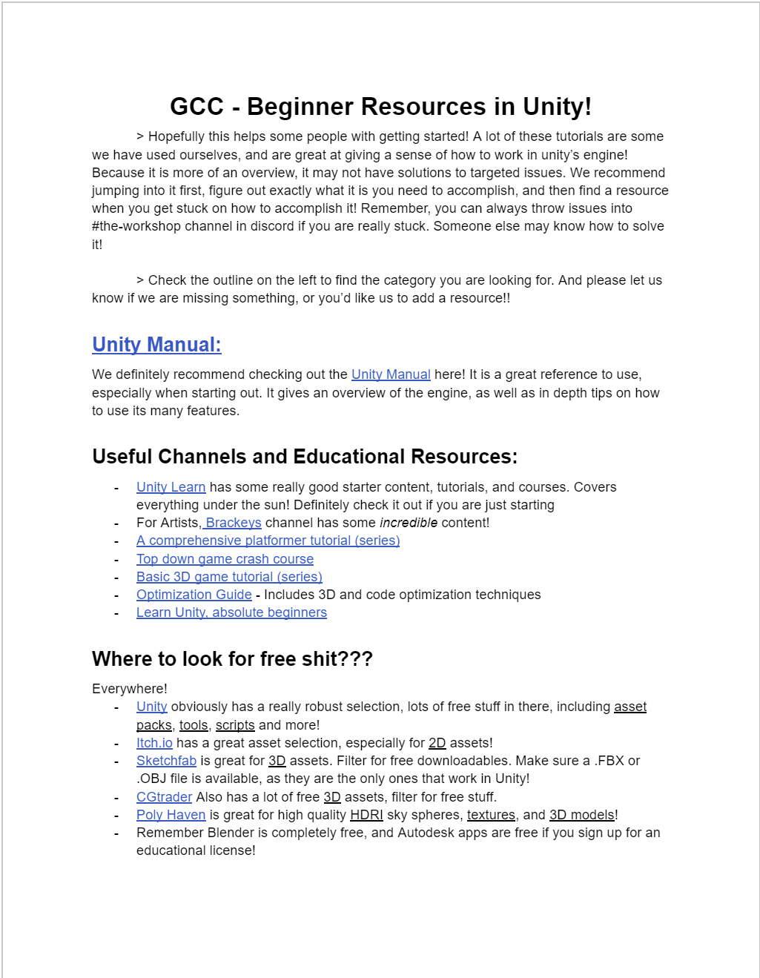
GCC Resources Doc
Game Creator Coalition at VCU’s Beginner Resources in Unity
Checkout the GCC Discord for Game Dev community at VCU

Slide 6
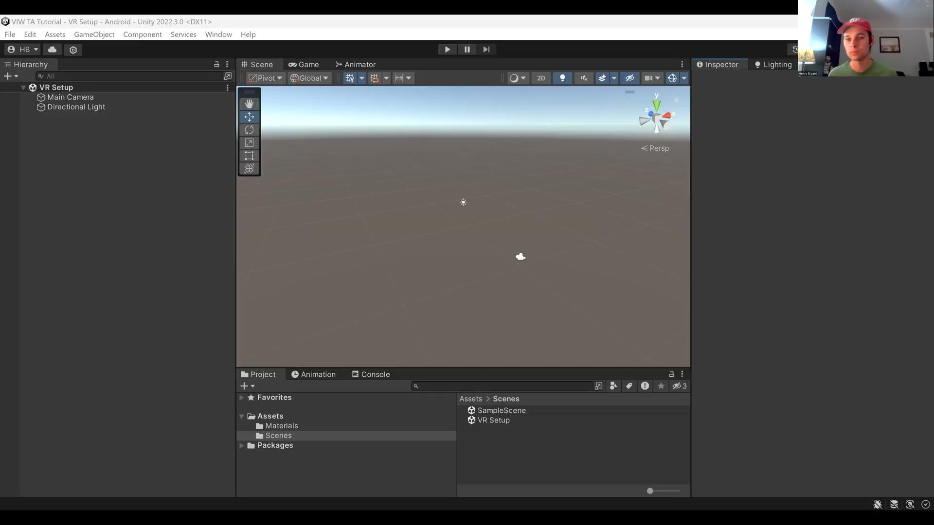
Tutorial

